Slide 1
Increasing Engagement with Make Happen During COVID-19 St. Helena School

Slide 2
Background
St. Helena school located in central Colchester
Approx. 570 students from Year 9-11
111 Uni Connect students
Activities in academic year 2019/20 – 4
Activities (to date) in academic year 2020/21 - 12

Slide 3
Background
Careers provisions managed by two members of staff
First full year in charge
Different backgrounds, educational and industry
Keen to build strong links with external providers and make the most of opportunities available to them

Slide 4
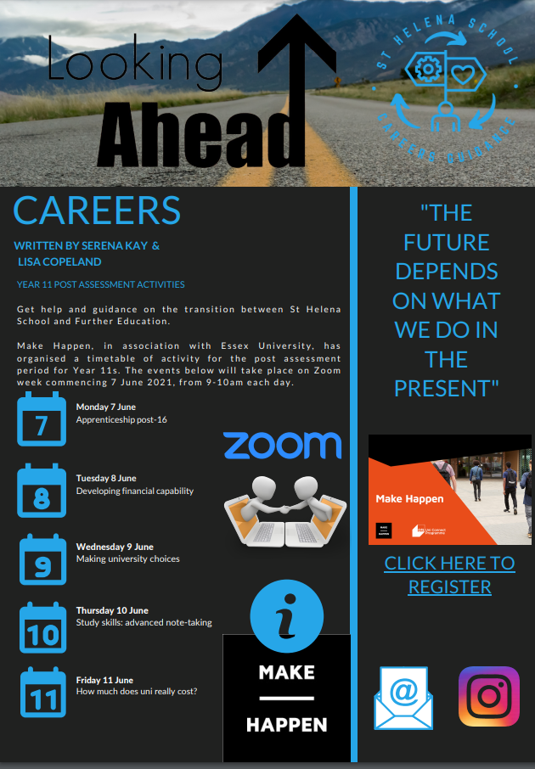
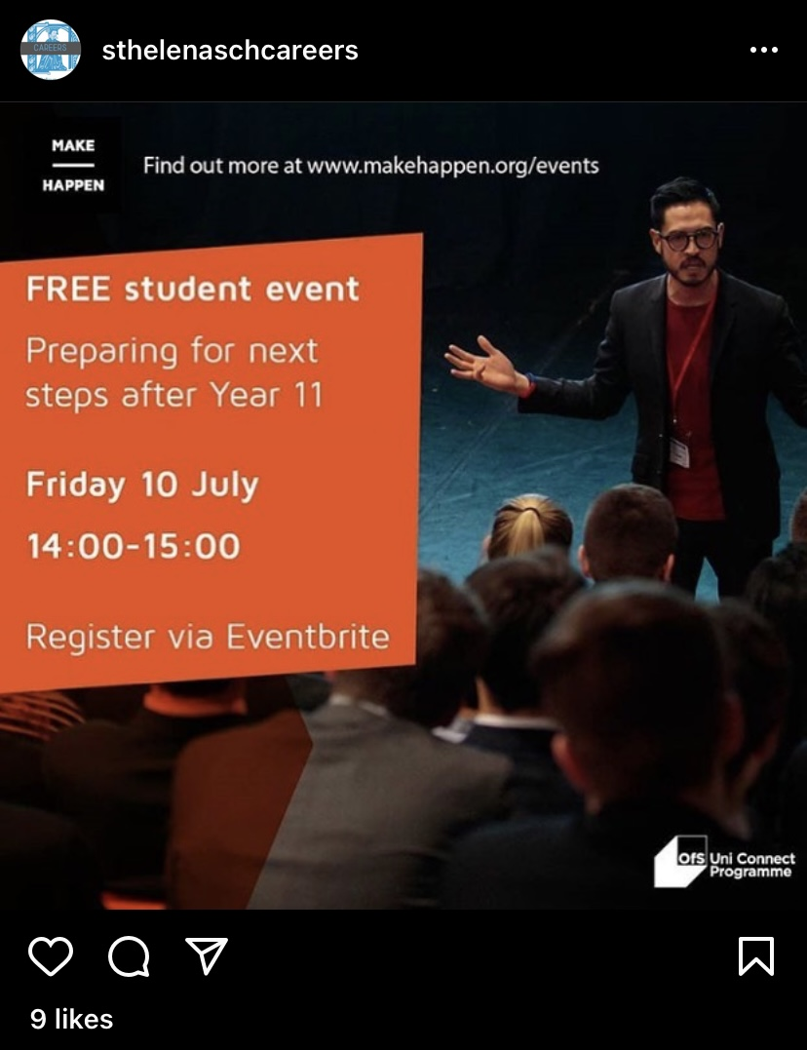
Increasing engagement
Looking at different ways to engage with students and parents
Google classroom
Instagram promotion
Community newsletter
Open Minds session

Slide 5
Increasing engagement
Member of SLT in careers team which helps get activities approved more quickly
Teachers are fully prepped before sessions in terms of technology and expectations
Regular team meetings to see how Make Happen opportunities can be taken forward
IT are on hand to advise on accessing online sessions

Slide 6
Increasing Engagement with Make Happen During COVID-19 l.french@makehappen.org

