Slide 2
Make Happen Update
What does the policy mean for us?
Stephen Pomfret
Head of Make Happen

Slide 3
Who we are – one page recap
Part of Uni Connect
Impartial collaborative outreach programme
Team of 20
School/College led approach
Notes:
29 UCP across the country – January 2017
Impartial Collaborative Outreach – UoE, ARU, UEL, WUC, FE Colleges, local authorities – areas of low progression – cold spots - signposting
Team – 3 hubs – cover the whole county
School/College led approach – identify the needs and challenges of a particular school or college

Slide 4
Make Happen – Partners
Notes:
We’re from Make Happen - a group of universities, colleges and other organizations working together to help students like you right across Essex think about their future options and career ambitions. This means we’re not here to just convince you to go to uni, or to choose a particular college. Our aim is to give you the broadest range of options so that you can make your mind up on what’s the right route for you. It also means we can give you a realistic view of what uni might be like!

Slide 5
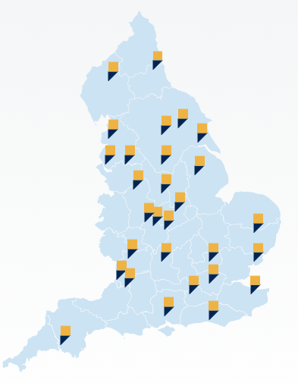
Uni Connect – the national picture
Reduction in funding - £30 million
Committed until 2024-25
Introduction of attainment raising
Central platform for collaboration and signposting
Notes:
Reduction in funding – 25% reduction in funding across the country however they are committed to the programme until 2024-25
Attainment raising – previously attainment raising was not permitted however the new director of fair access has brought a change in approach. Universities are being asked to support this agenda and so is UC
Central – continue to provide a space for collaboration and signposting to activity and resources across the region and country

Slide 6
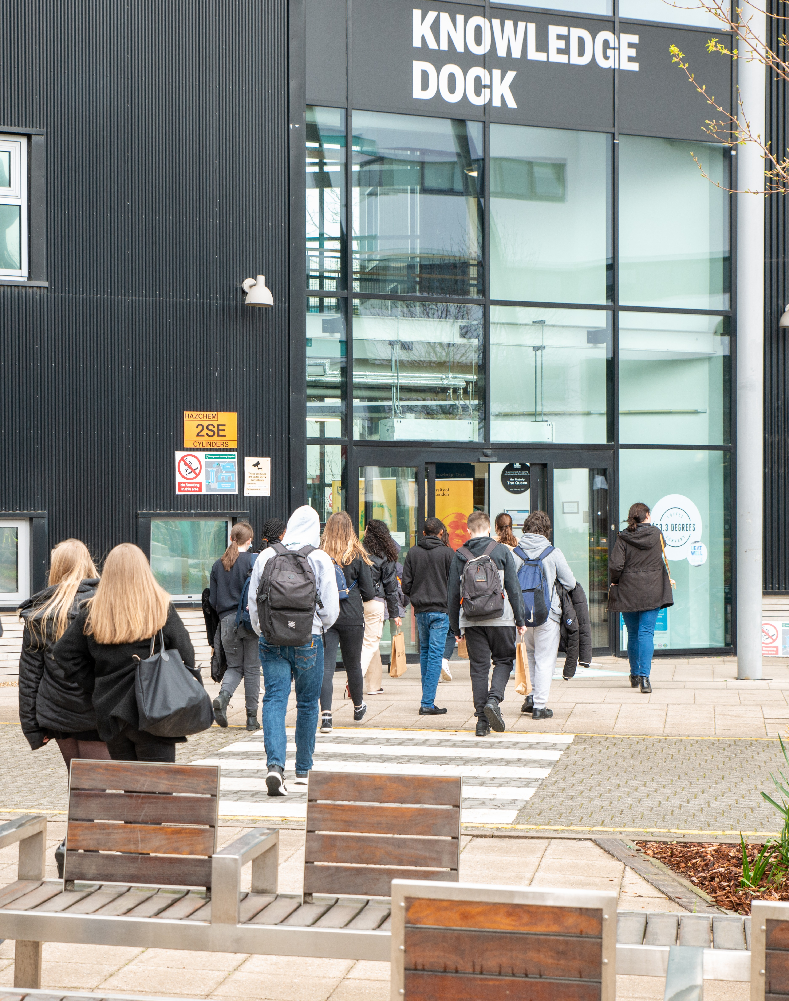
Make Happen – the local picture
Reduction in funding – 28%
Retaining staff
Opportunities for new activity – raising attainment
Work with under-represented groups
Collaborative Working
Notes:
Reduction in funding – we have had a significant cut over the last two years. However, we are in a strong position and still have a budget of over £1.3 million.
Staff – as in previous years we recognise that our greatest resource is staff. Being able to have in depth conversations with schools/colleges/partners allows us to understand and join the dots.
Raising attainment – will work with partners across 2022/23 to develop a programme for the coming year. Discussions with schools will be a key part of this planning
Under-represented – will continue to expand our work with under-represented groups such as LAC, SEND, military families
Collaborative working – all of this will be underpinned by our partners and working closely with them

Slide 7
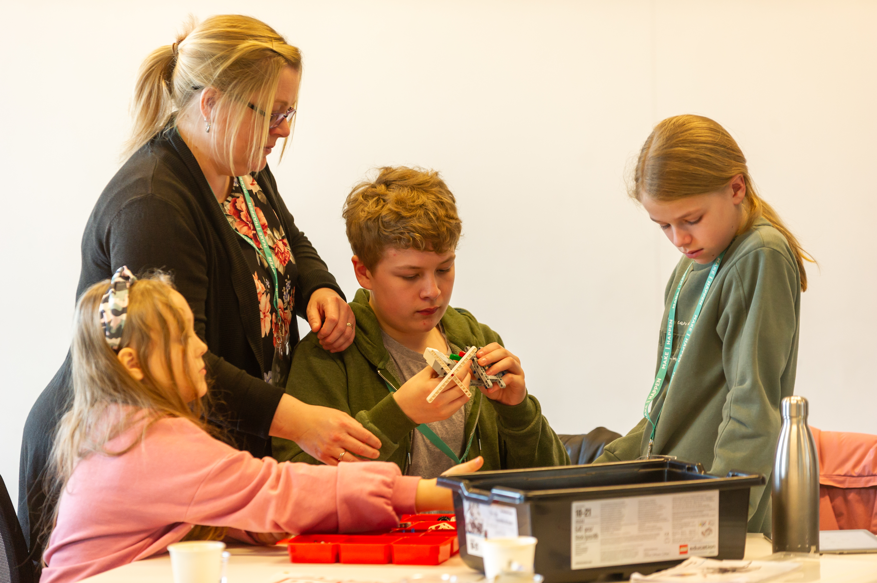
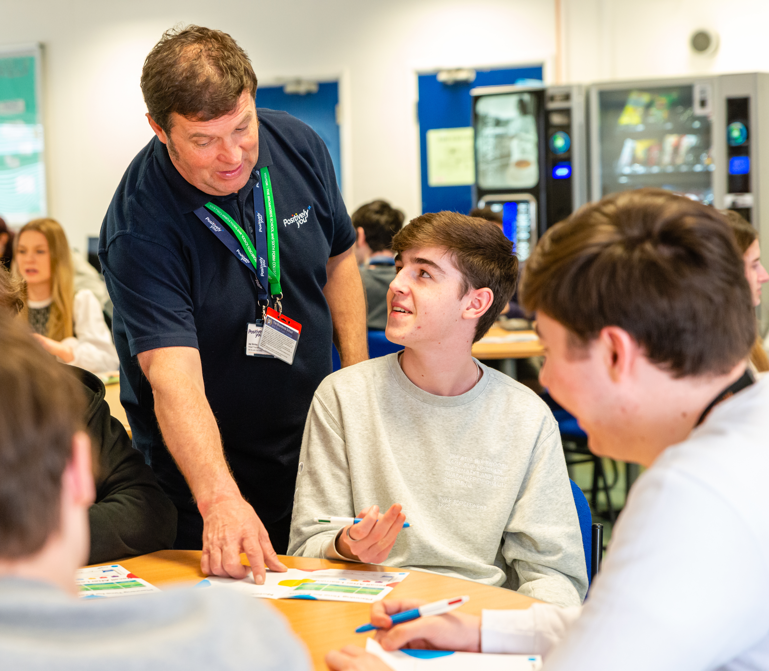
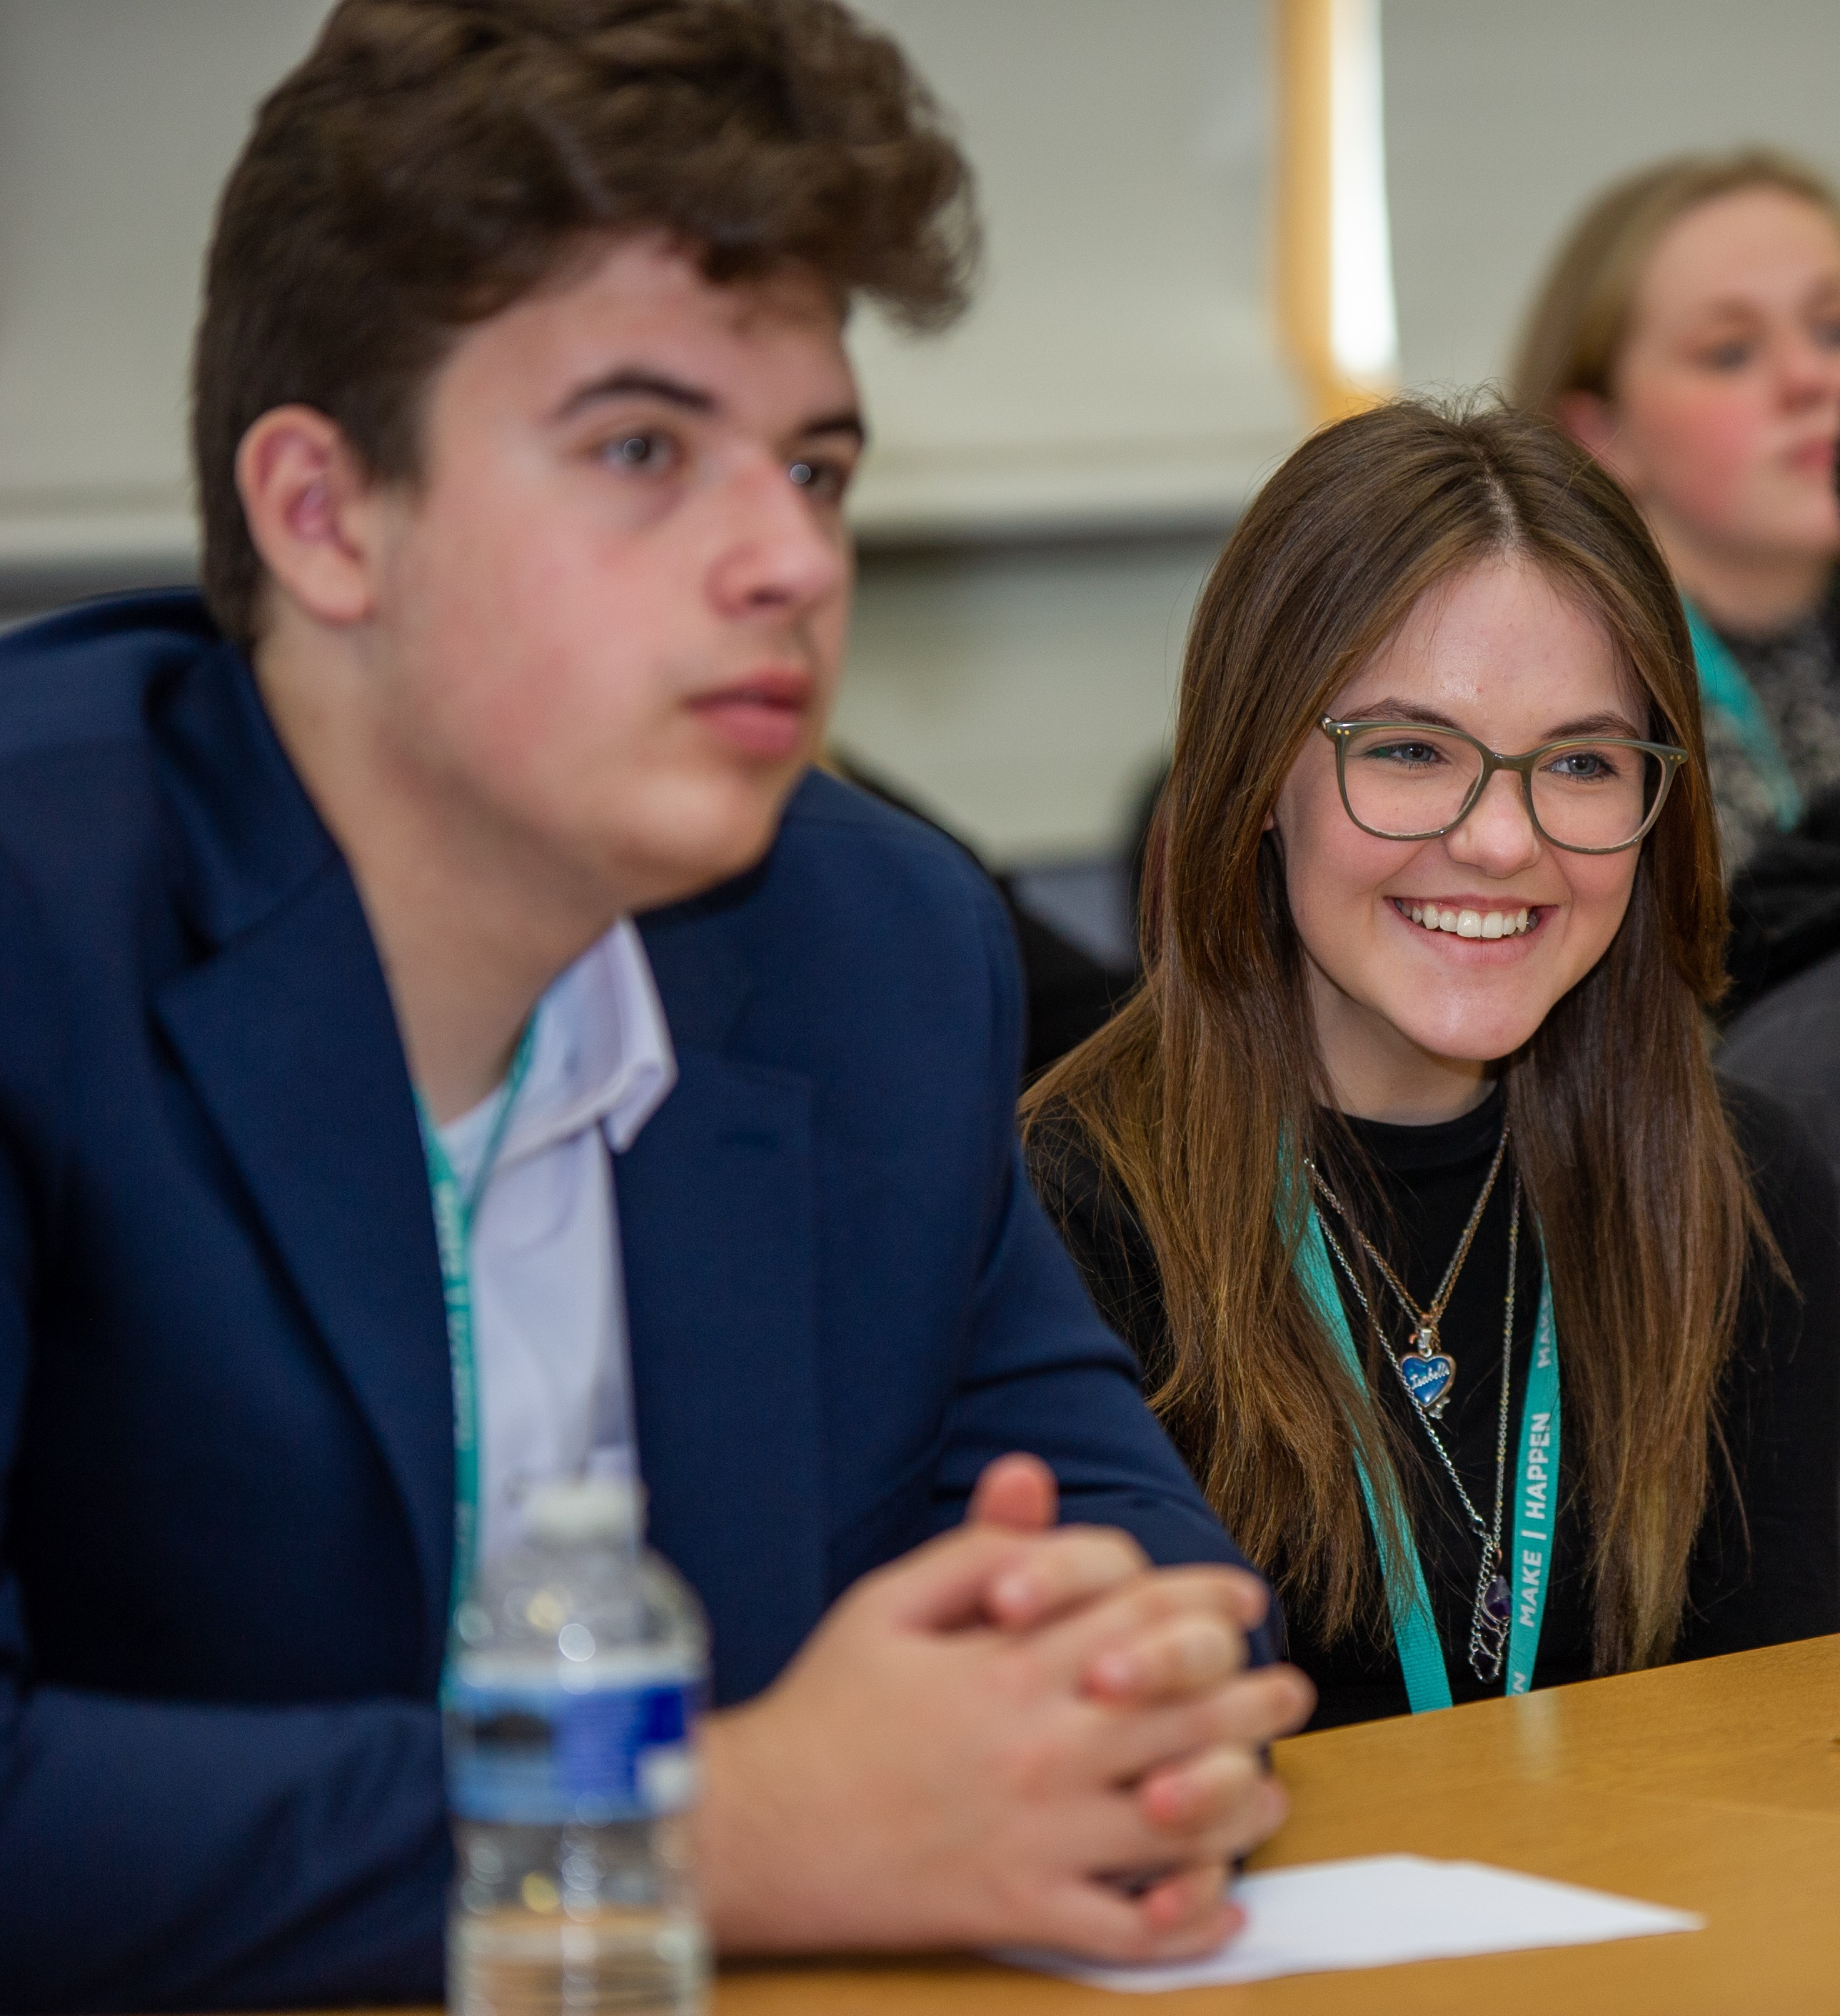
Thank You!!!!
13102
5119
8561
Notes:
13102 – students worked with in 21/22
5119 – from UC wards
8561 – face to face

Slide 8
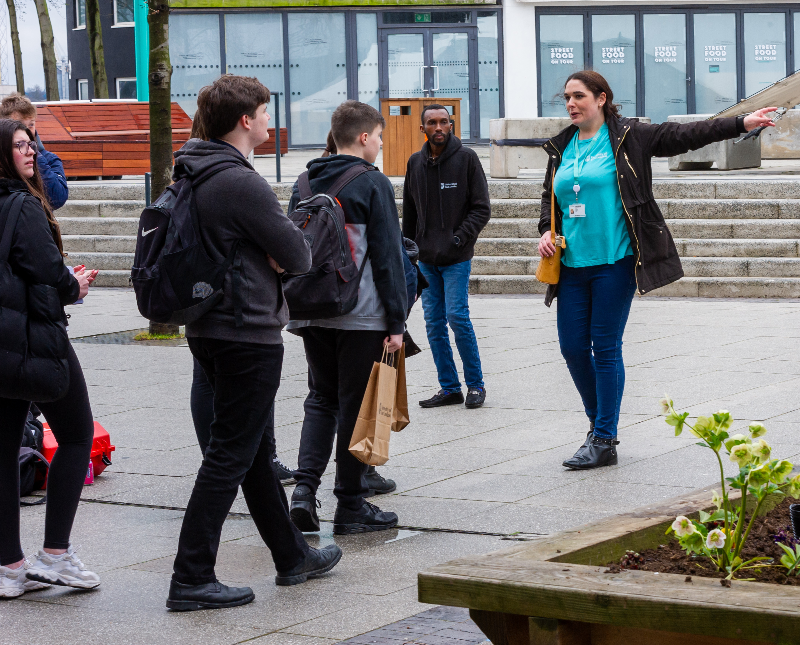
Thank You!!!!
475
55
121
Notes:
475 activities delivered or booked for this year – 94 in March
55 on campus events with 250 students
121 – online events – keeping what we learned from the pandemic

Slide 9
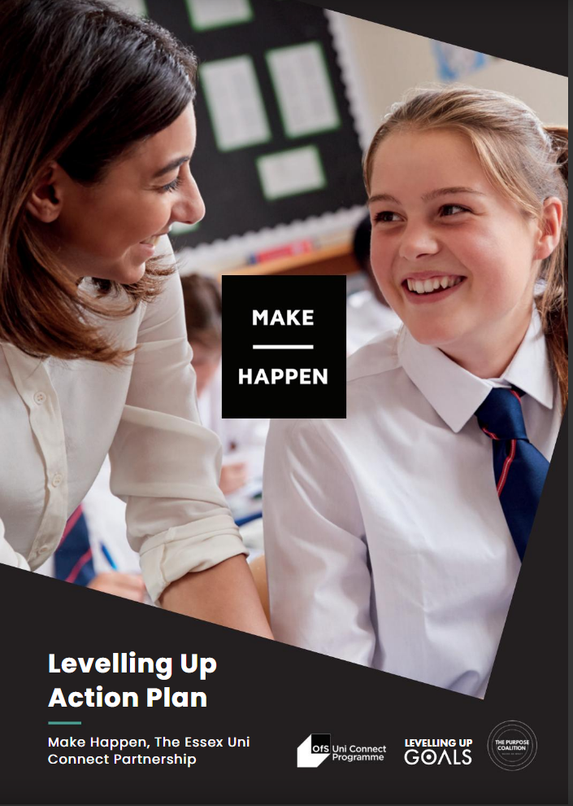
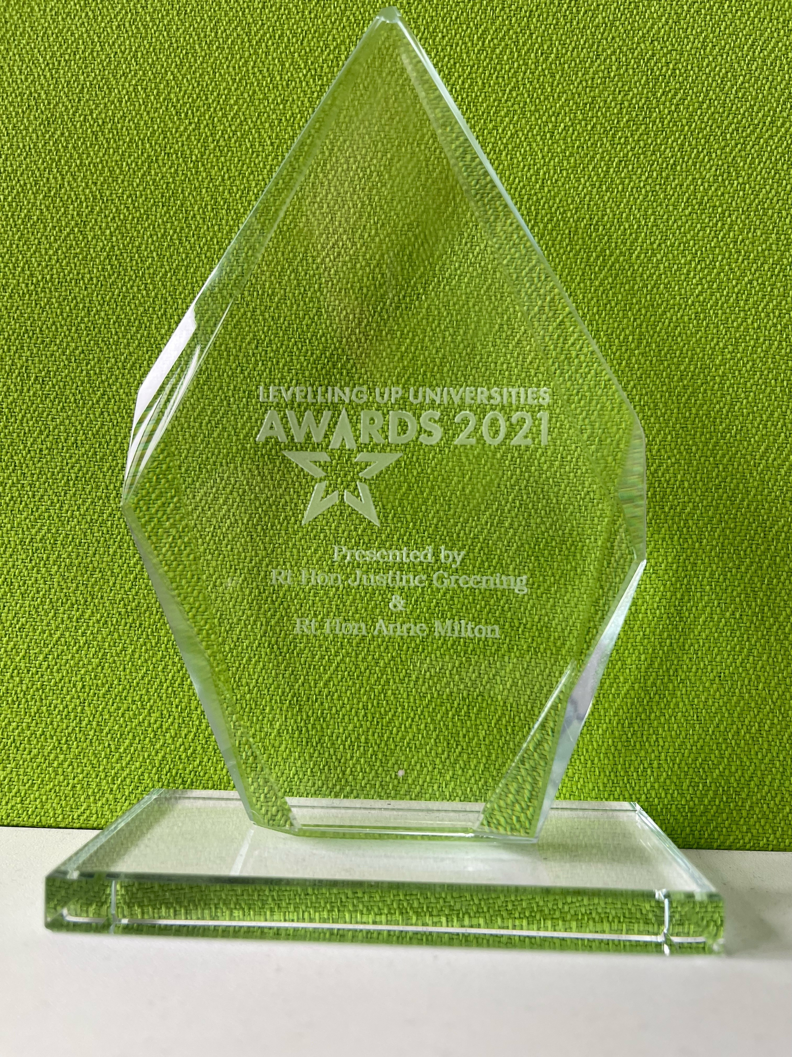
Thank You!!!!
Notes:
Put in a selection of charts showing engagement – talk about Future Stars, SCIP Alliance Hub, launch of PC, Levelling Up Award, Nomination for NEON award
NEON award – outreach school or college of the year – nomination for James Hornsby School
SCIP – establishment of the East Anglian Hub and co-chair of the group
Levelling Up plan – worked with Purpose Coalition and Justine Greening to produce a levelling up action plan for the programme
Levelling Up award – won an award for our outstanding contribution to levelling up
Future Stars – collaborative programme to support LAC

